Slide 1
2022 Ideas

Slide 2
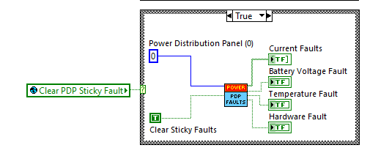
Clear PDP Sticky Faults in Teleop

Slide 3
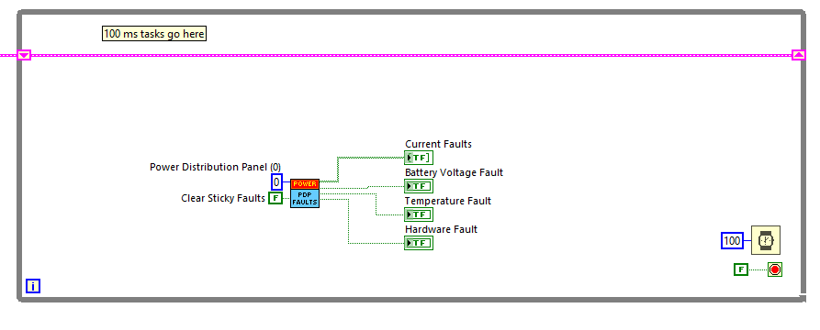
Clear PDP Sticky Faults in Periodic Task?

Slide 4
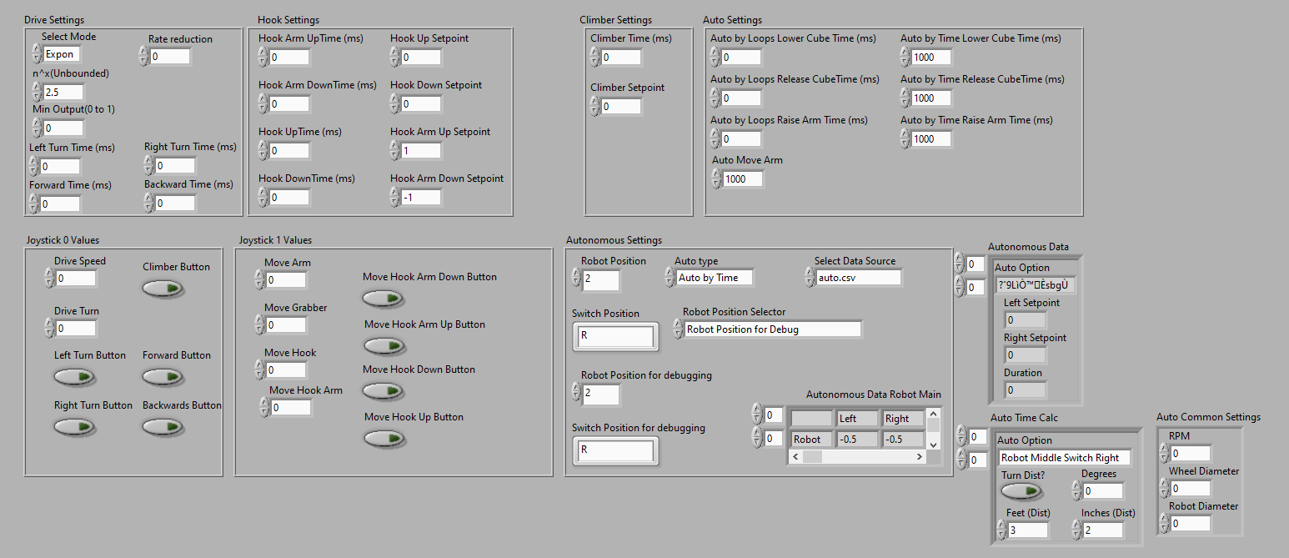
Robot Global Data

Slide 5
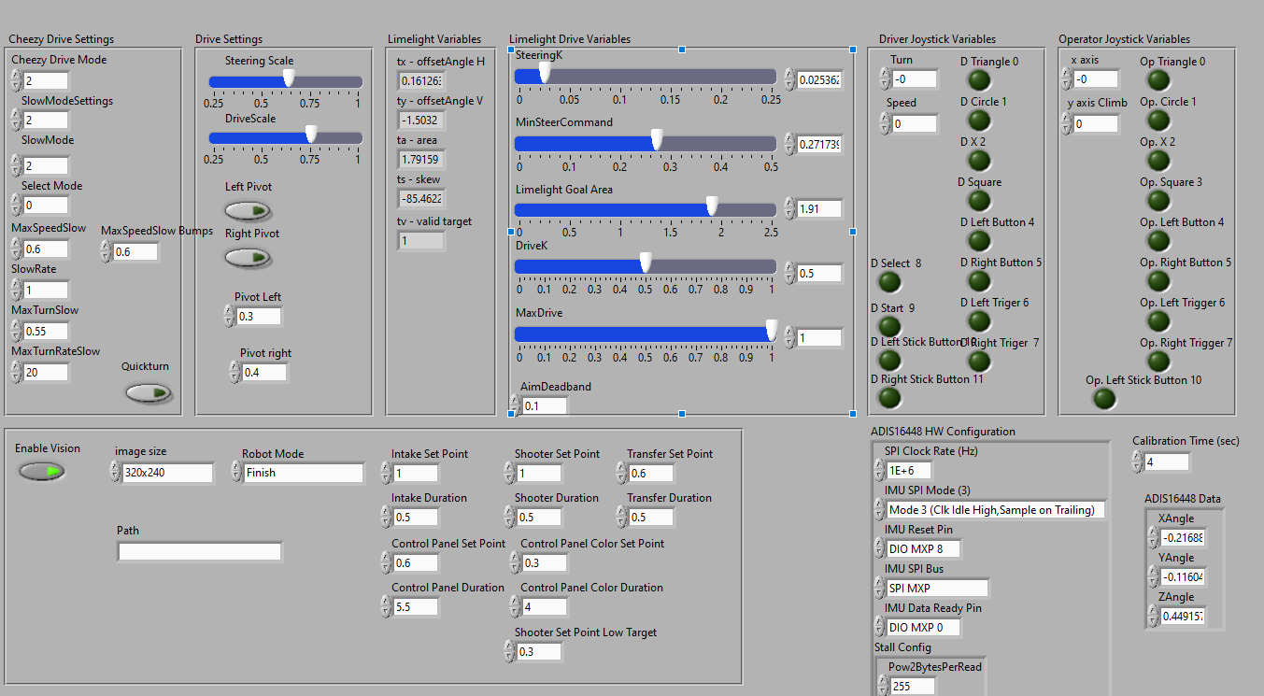
Robot Global Data

Slide 6
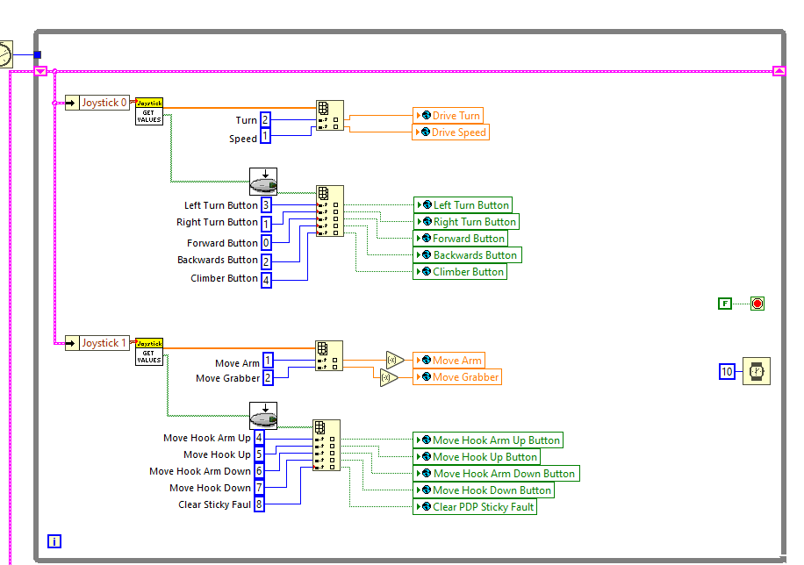
Read Joysticks

Slide 7
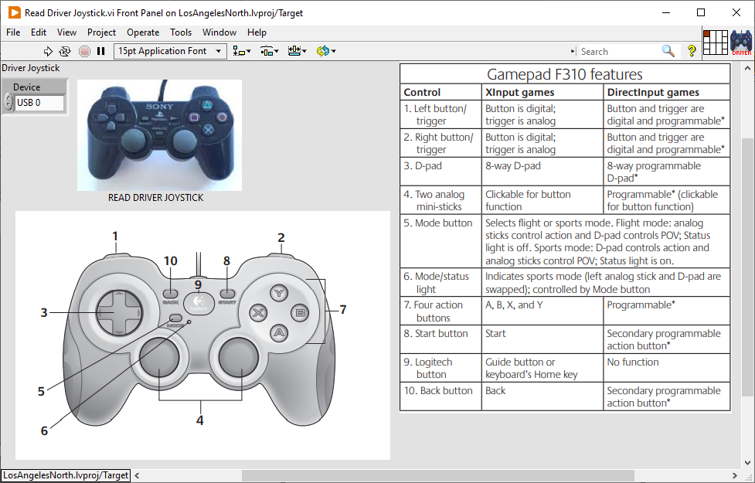
Read Joysticks

Slide 8
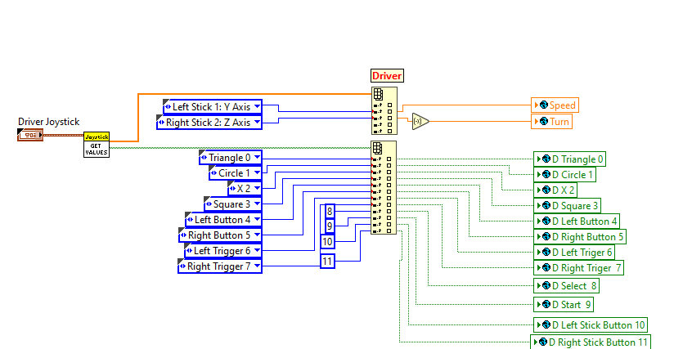
Read Joysticks

Slide 9
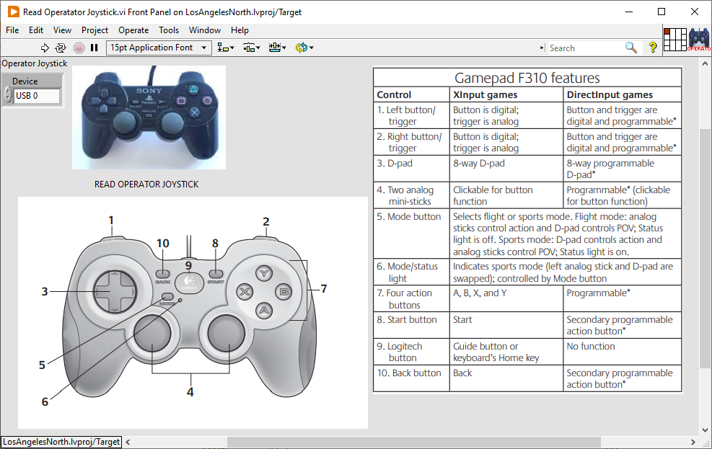
Read Joysticks

Slide 10
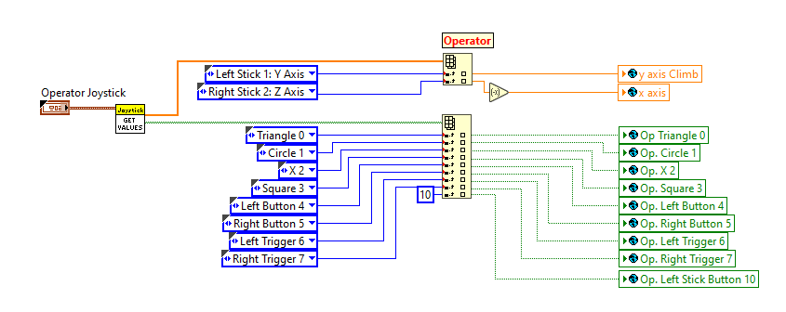
Read Joysticks

Slide 11
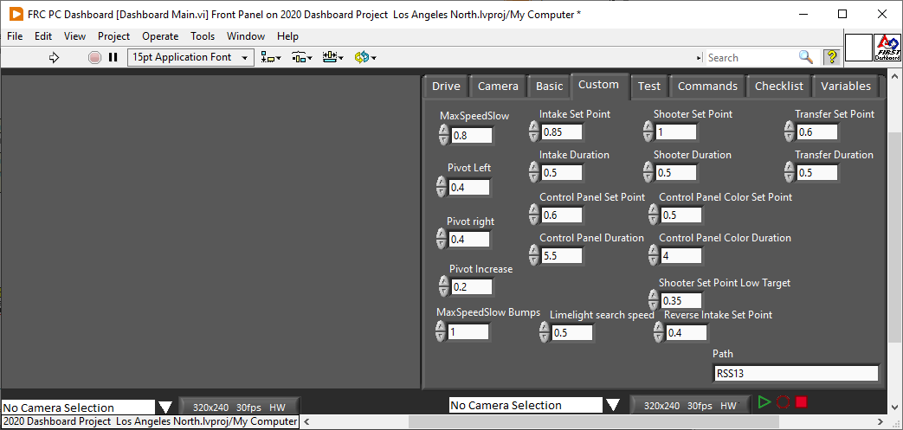
Add Dashboard Variables

Slide 12
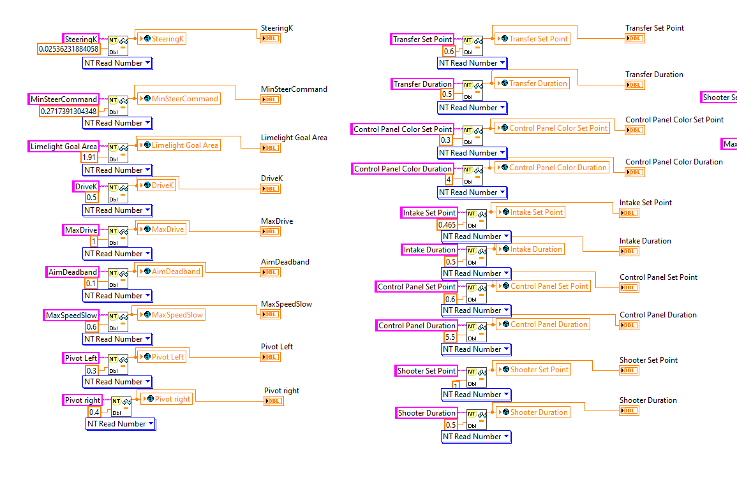
Read Dashboard Variables

Slide 13
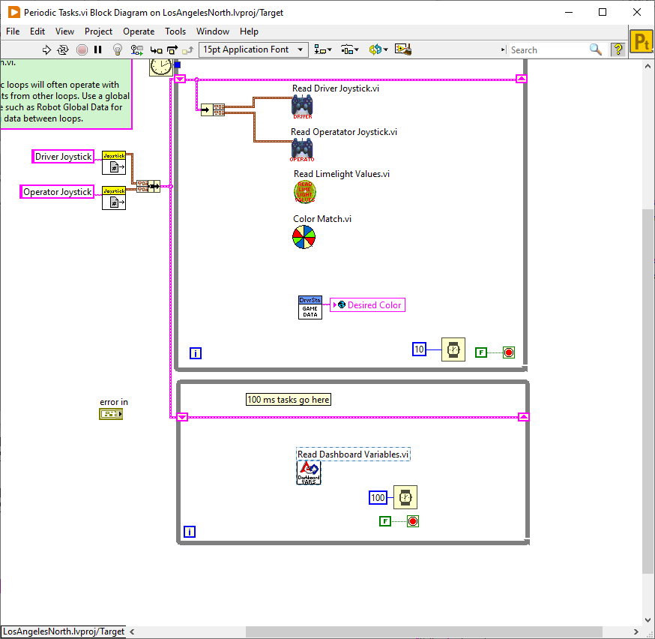
Read Dashboard Variables

Slide 14
Clear PDP Sticky Faults

